Slide 1
Text Classification
Presented by:- Kartikya Singhal
[ B.tech CSE]
(2016814)
Guided by:- Ms. Garima Sharma

Slide 2
What is Text Classification?
Text classification is a machine learning technique that assigns a set of predefined categories to open-ended text.
Automated text classification has been considered a vital method to manage and process the vast amount of document in digital form that are widespread and continuously increasing
Text classification is one of the fundamental tasks in natural language processing with broad applications such as sentiment analysis, topic labeling, spam detection, and intent detection.

Slide 3
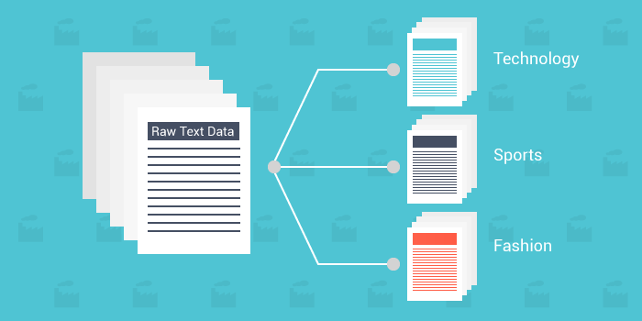
Introduction
Here’s an example of how it works:
“The movie is good and the characters are awesome.”
A text classifier can take this phrase as an input, analyze its content, and then automatically classify it as positive review.

Slide 4
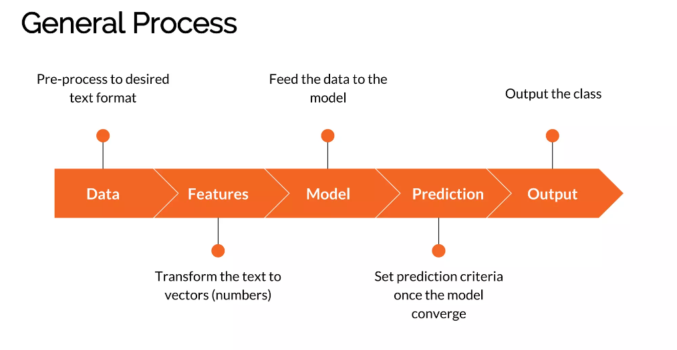
Methodology

Slide 5
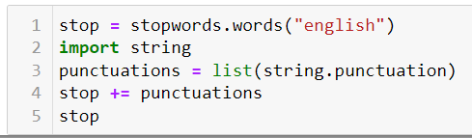
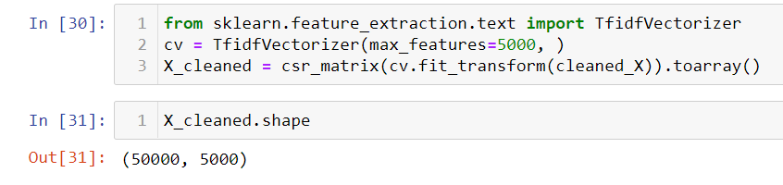
Preprocessing
Preprocessing step includes removing of stop words and punctuation and cleaning the review and then applying the Tfid vectorizer.

Slide 6

Multinomial Naïve Bayes
The Multinomial Naive Bayes algorithm is a Bayesian learning approach popular in Natural Language Processing (NLP).
It calculates each tag's likelihood for a given sample and outputs the tag with the greatest chance.
The main idea behind the naïve Bayes is that all features in 𝑾 independently contribute to the probability that 𝑺 belongs to 𝑪ₖ.
The algorithm is based on the Bayes theorem and predicts the tag of a text
Bayesian Probability Formulae

Slide 7
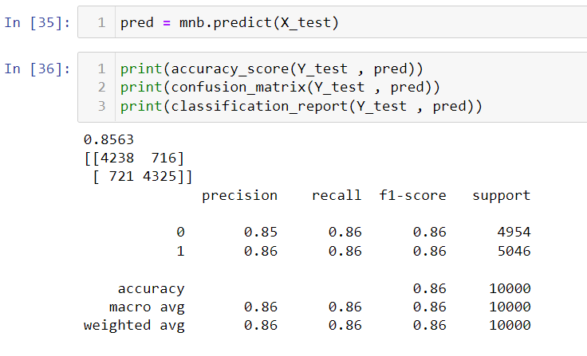
Result and Discussion
As seen in the image the accuracy on the test data is 85%.
The accuracy is low because of many variations in the dataset and due to its large size.
Our model is also working well on the user provided data also, as seen in the next slide.

Slide 8
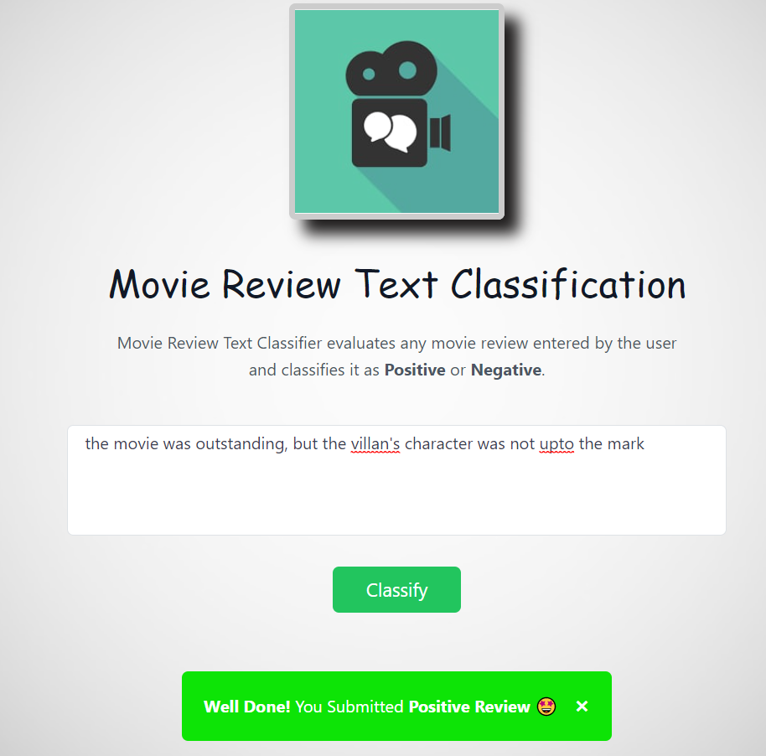
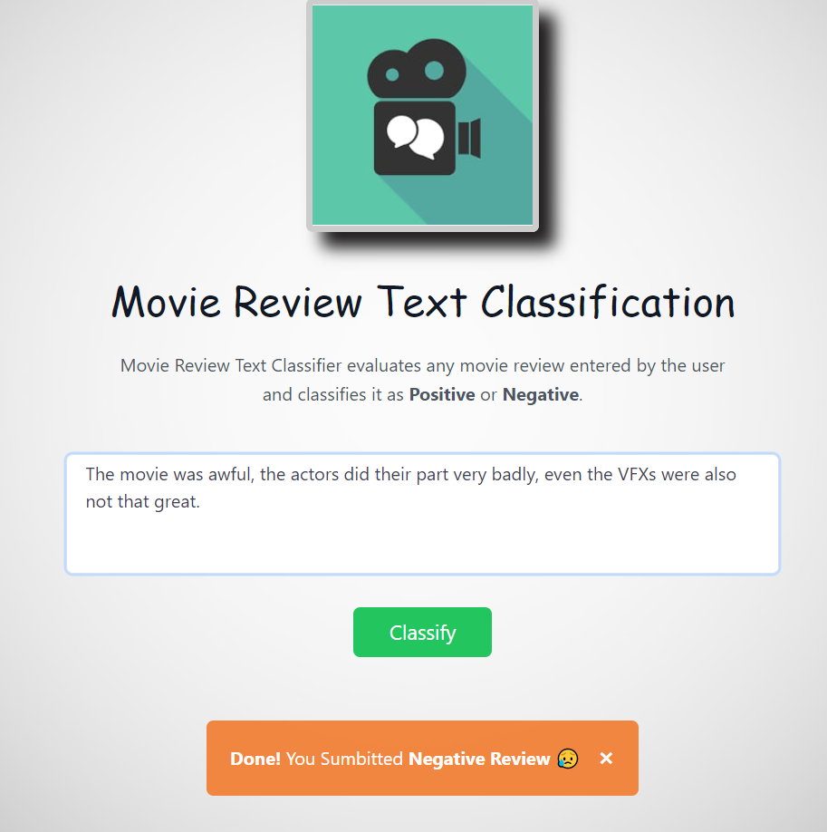
Prediction on user provided review

Slide 9
Conclusion and Future Work
CONCLUSION:
I used Multinomial naïve bayes for the text classification and it give accuracy of about 85%.
Text classification technique was used for classifying the Movie review into two categories i.e. Positive review and Negative review.
FUTURE WORK:
We used text classification for classifying the movie review but it can be used to accomplish various tasks that are likely to be extremely useful: document classification, tagging domain-specific entities in text, and building structured databases through relation extraction.
it is suggested that their adoption will have the greatest impact on the construction of large scale comparative databases.

Slide 10


